Slide 1
Code optimization

Slide 2
Code optimization
Tries to improve the code by
Eliminating the unwanted code lines
Rearranging the statements of the code

Slide 3
Advantages of code optimization
faster execution speed.
Optimized code utilizes the memory efficiently.
Optimized code gives better performance.

Slide 4
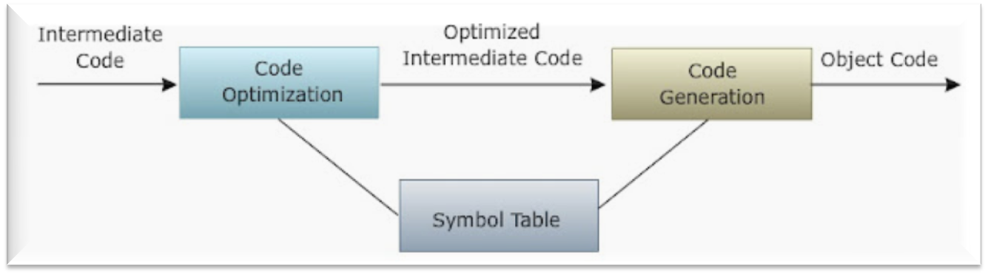
Code optimization

Slide 5
principle sources of optimization
Common-Sub expression Elimination
Copy Propagation
Dead Code Elimination
Compile time evaluation
Code movement(code motion)
Strength reduction
Induction variable elimination

Slide 6
1. Common-Sub expression Elimination
Eliminating the common sub expressions
The expression that has been already computed before and appears again in the code for computation is called as common sub expression

Slide 7


Code before optimization
Code after optimization

Slide 8
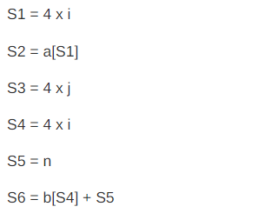
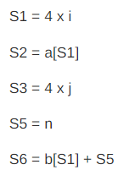
Code before optimization
Code after optimization

Slide 9
2.Copy propagation
Assignments of the form f : = g called copy statements.
This may not appear to be an improvement
Copy propagation means use of one variable
instead of another.
Elimination of copies in the code is Copy
Propagation.

Slide 10
Copy propagation
Code before optimization
Code after optimization
y = x
z = 3 + y
z = 3 + x

Slide 11
Copy propagation
Code before optimization
Code after optimization
x=Pi;
A=x*r*r;
A=Pi*r*r;

Slide 12
3. Dead code elimination
The statements of the code which never
executes or unreachable or their output
is never used , are called dead code
By eliminating these dead code from a
code, the code will get optimized.

Slide 13
Dead code elimination
Code before optimization
Code after optimization
i=0;
If(i==1)
{
a=x+i;
}
i=0;

Slide 14
Dead code elimination
Code before optimization
Code after optimization
int x= a+23;
z=a+y; printf("%d,%d".z,y);
z=a+y;
printf("%d,%d".z,y);

Slide 15
4.Compile time evaluation
Evaluation is done at compile time instead of run time
    Constant Folding
    Constant propagation

Slide 16
Constant Folding
The expression that contain the
operands having constant values at
compile time are evaluated
These expressions are then replaced
with their respective values

Slide 17
Constant Folding
Example
area=(22/7)*r*r
Here 22/7 is calculated at compile time and the expression is then replaced with its result 3.14

Slide 18
Constant propagation
If some variable has been assigned some constant value, then it replaces that variable with its constant value in further program during compilation
Example:
pi=3.14
radius=10
area=pi*radius*radius

Slide 19
5. Code movement(code motion)
The code present inside the loop is moved out if it does not matter whether it is present inside or outside
Such a code unnecessarily gets execute again and again with each iteration of loop

Slide 20
Code movement
Code before optimization
Code after optimization
x=y+z;
for(i=0;i<n;i++)
{
a[i]=6*i;
}
for(i=0;i<n;i++)
{
x=y+z;
a[i]=6*i;
}

Slide 21
6. Strength reduction
Strength reduction means replacing the
high strength operator with a low strength.

Slide 22
Strength reduction
Code before optimization
Code after optimization
b=a+a
b=a*2

Slide 23
7. Induction variable elimination
Some loops contain two or more induction variables that can be combined into one induction variable

Slide 24
Code before optimization
Code after optimization
int a[size];
int b[size];
void f(void)
{
int i1,i2,i3;
for(i1=0,i2=0,i3=0;i1<size;i1++)
a[i2++]=b[i3++]
return;
}
int a[size];
int b[size];
void f(void)
{
int i1;
for(i1=0;i1<size;i1++)
a[i1]=b[i1]
return;
}

